Slide 1




Eli Arbel
elia@codevalue.net
http://arbel.net/

Slide 2
About CodeValue
CodeValue is the home of software experts
CodeValue builds software tools, foundations and products for the software industry
CodeValue offers mentoring, consulting and project development services
We love technologies, we believe in excellency
http://codevalue.net/

Slide 3
agenda
introduction
silverlight development
phone development
using azure in your app
the marketplace

Slide 4
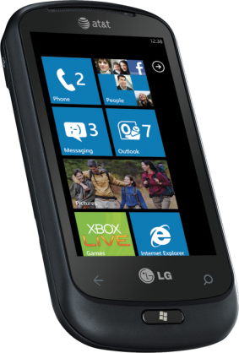
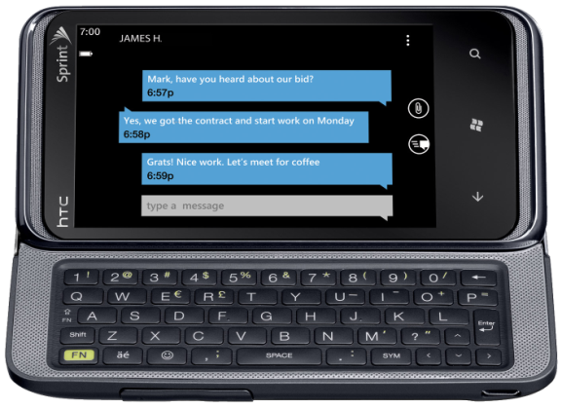
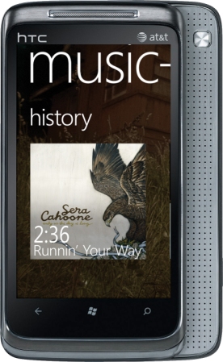
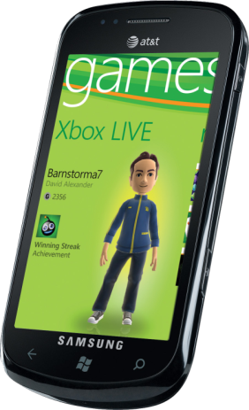
introduction
features metro tools cloud
new platform
based on familiar technologies and tools
multiple hardware vendors
consistent baseline (cpu, resolution, etc.)
your chance to enter a brand new market!

Slide 5
introduction
features metro tools cloud
METRO IS WINDOWS PHONE’S DESIGN LANGUAGE. IT’S MODERN AND CLEAN. IT’S ABOUT TYPOGRAPHY AND CONTENT.

Slide 6


Slide 7
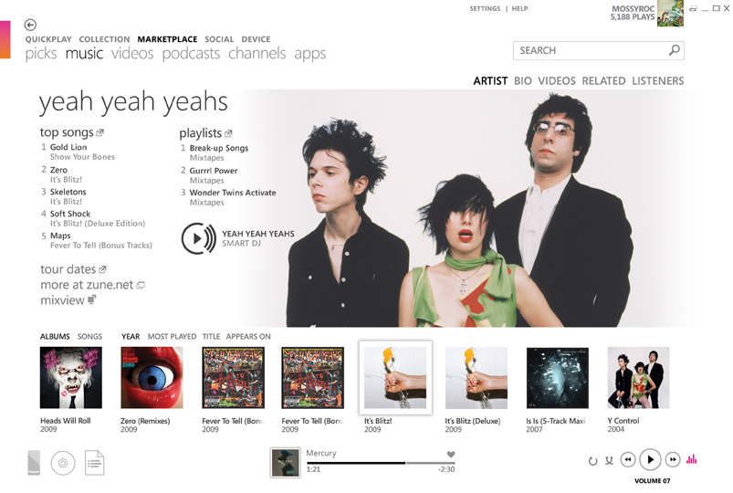
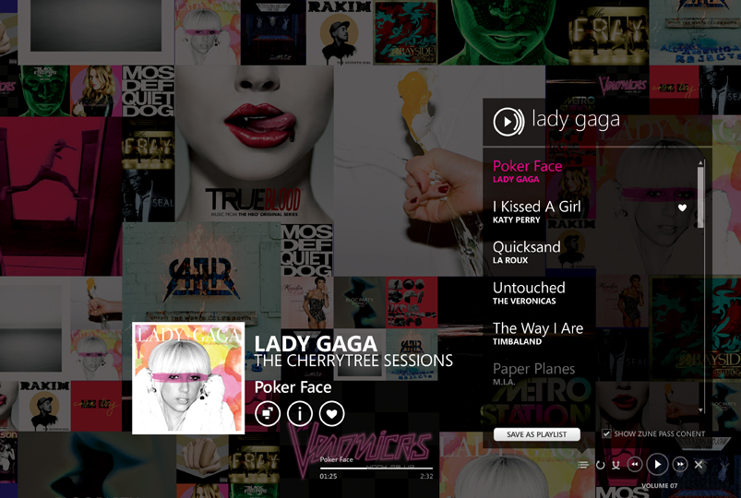
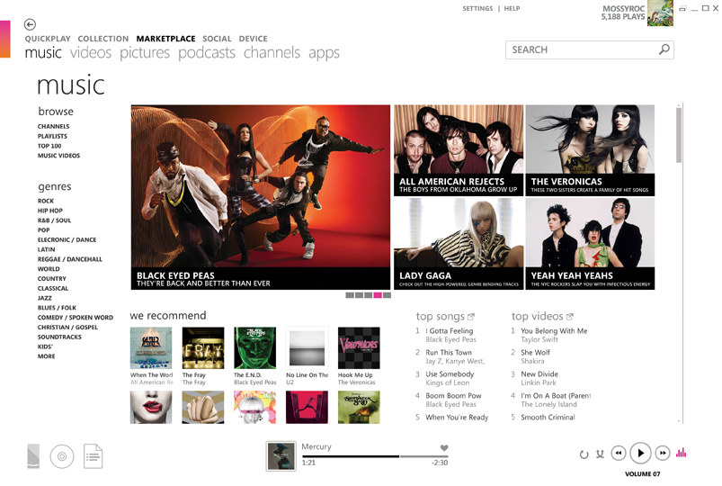
metro

Slide 8
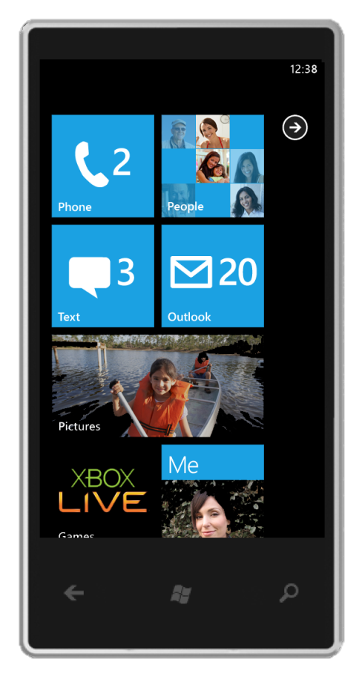
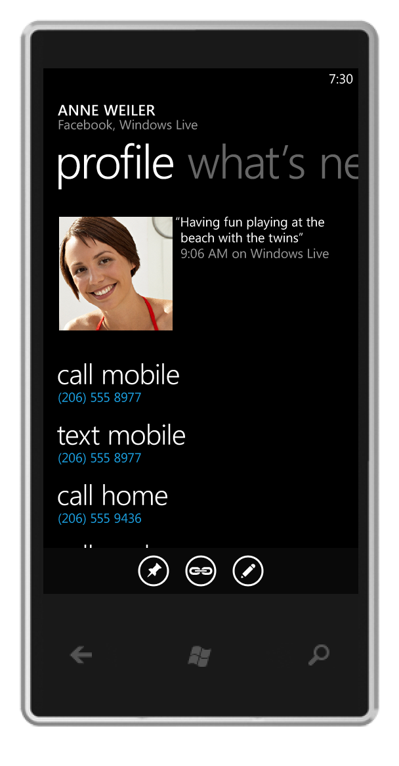
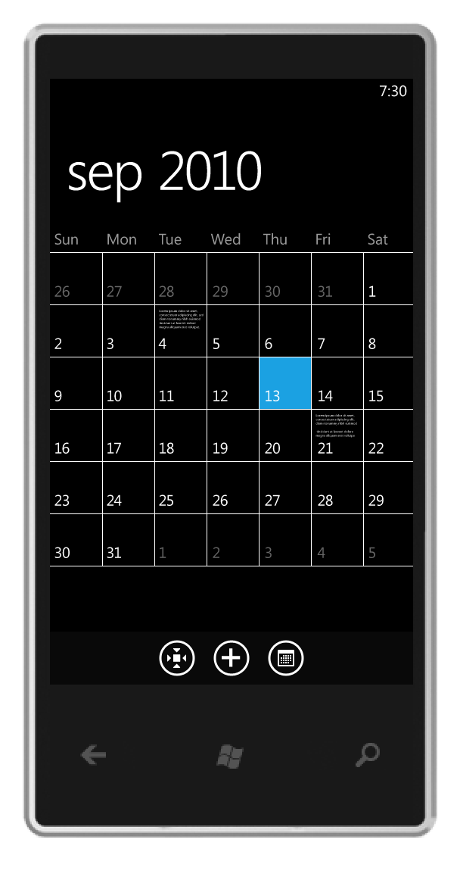
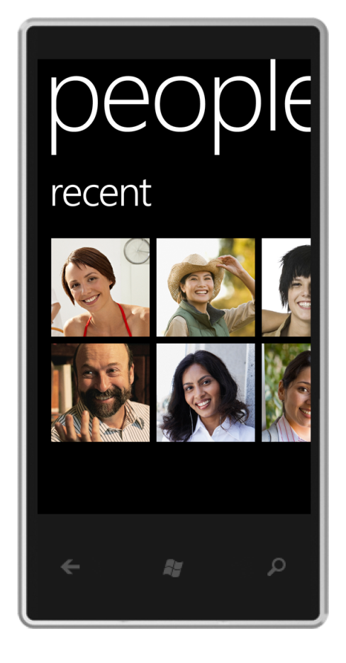
metro

Slide 9
metro
principals
clean, light, open, fast
celebrate typography
alive in motion
content, not chrome

Slide 10
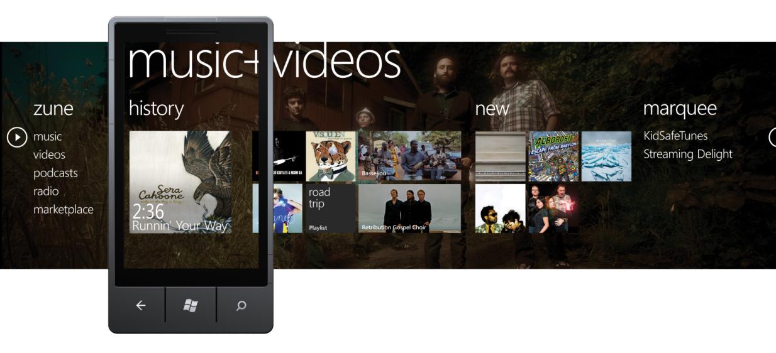
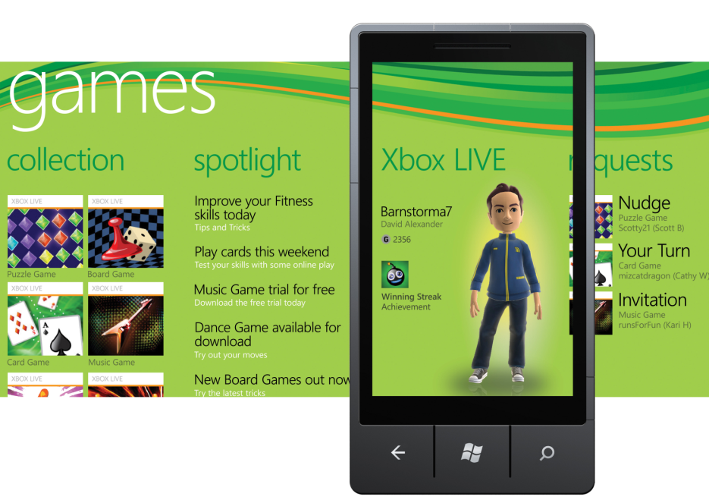
metro
app hubs

Slide 11



introduction
features metro tools cloud
Phone Emulator
Samples
Documentation
Guides
Community
Packaging and Verification Tools

Slide 12

introduction
features metro tools cloud
Notifications
App Deployment
Location
Identity
Feeds
Social
Maps

Slide 13
silverlight

Slide 14
silverlight
introduction
a subset of the .net framework and WPF
first introduced as a browser plug-in
.net runtime on multiple platforms (mac, windows)
currently targeted for:
device apps (currently windows phones)
client apps (emphasis on enterprise)
rich media apps (such as streaming video)
reuse code for desktop, web and phone apps!

Slide 15
silverlight
principals
code + xaml
controls
layout
data binding
graphics

Slide 16
code + xaml
xaml is basically a declarative language for object instantiation
xaml is great for UI development. it’s:
standard XML
hierarchical
extensible
declarative
we can do most things both in xaml and in code, but you’ll quickly find that xaml is much more convenient for some tasks

Slide 17
code + xaml
comparison
XAML
<Grid x:Name="ContentPanel"
Margin="12,0,12,0">
<TextBlock Text="Hello, Windows Phone 7!"
Margin="6"
HorizontalAlignment="Center"
VerticalAlignment="Center" />
</Grid>
C#
var tb = new TextBlock();
tb.Text = "Hello, Windows Phone 7!"; tb.HorizontalAlignment = HorizontalAlignment.Left; tb.VerticalAlignment = VerticalAlignment.Top;
tb.Margin = new Thickness(6);
ContentPanel.Children.Add(tb);

Slide 18
code + xaml
the visual tree
controls contain other controls, and some controls are built using other controls
this creates a hierarchical relationship between the controls which we call the visual tree
when you write xaml, the structure of the visual tree is very clear

Slide 19
demo
hello, xaml
Notes:
on the fly

Slide 20

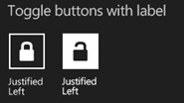




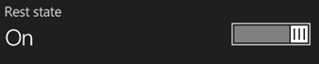

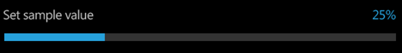

controls

Slide 21
controls
anatomy
inherits from FrameworkElement
two main types:
custom control – a reusable, templatable control (e.g. a button)
user control – a way to modularize your application (e.g. employee view)
uses dependency properties and routed events
responds to input (touch, keyboard)

Slide 22
controls
dependency properties
extend CLR properties with:
data binding
change notification
animation
validation
control-tree inheritance

Slide 23
controls
routed events
extend CLR events
can travel along the visual tree:
bubbling or tunneling

Slide 24
controls
routed events
Root
Element 1
Element 2
Element1.1
Element 1.2
Element 2.1
Element 2.2
PreviewMouseDown on Root
PreviewMouseDown on Element 1
PreviewMouseDown on Element 1.2
MouseDown (bubble) on Element 1.2
MouseDown (bubble) on Element 1
MouseDown (bubble) on Root

Slide 25
layout
basic properties
Container
Vertical Alignment
Margin
Horizontal
Alignment
Padding
Element
{Min, Max}
Height
Render Transform
{Min, Max} Width

Slide 26
layout
panels
Grid
StackPanel
WrapPanel (*)
Canvas
* can be found in the silverlight toolkit

Slide 27
demo
layout with panels

Slide 28
controls
styles
defines a set of dependency properties and values
similar to CSS in HTML
provides a great way to control the looks of your app from a central location

Slide 29
controls
templates
completely customize appearance of controls without having to write any code or inherit from the control
all controls have default styles and templates
template editing is easy with Expression Blend

Slide 30
demo
template editing in blend
Notes:
on the fly

Slide 31
data binding
flow data from a source to a target
source: any CLR object
target: Dependency Property only
modes: one way, two way
supports change notifications
changes to a source object automatically sent to the UI
both property and collection changes are supported

Slide 32
data binding
data templates
provide a visual representation of an object
the default behavior if no template is specified is to display the Object.ToString() result
use bindings to display data
respond to changes using triggers
can only be written in xaml

Slide 33
data binding
collections
use ItemsControl whenever you need to bind to a collection
provide an ItemTemplate to change the visuals of each item
controls that inherit from ItemsControl:
ListBox, ContextMenu, MenuItem, Panorama

Slide 34
demo
data binding

Slide 35
data binding
the mvvm pattern
designed specifically with WPF/Silverlight in mind
relies on bindings to retrieve and set data from and to the view model
uses commands to perform operations on the view model
relies on notifications to communicate between the layers
creates a data-driven UI
Model
business logic and data
View Model
presentation logic and state
View
UI (and possibly some UI logic)

Slide 36
graphics
images
store images as resources or as content
content is recommended
use the Image control to show them
use WritableBitmap to create images in runtime
you can also use it to capture your screens

Slide 37
graphics
vectors
controls inheriting from Shape can be used to create 2D shapes
Rectangle, Ellipse, Line, Polyline, Polygon, Path
Path is the most versatile, accepting a Geometry object which can represent any shape
it is easiest to create shapes using Expression Blend

Slide 38
graphics
transforms
FrameworkElement has a RenderTransform property which can be assigned to:
TranslateTransform (move)
ScaleTransform
RotateTransform
SkewTransform
CompositeTransform (combine any of the above)
additionally, the Projection property allows creating 3D-like effects

Slide 39
graphics
animations
animate dependency property using a Timeline that fits the property type:
DoubleAnimation, ColorAnimation, PointAnimation
use Storyboard to group a few animations together
use an easing function to make the animation look more “real” (e.g. to add elasticity)
it’s easiest to create storyboards in xaml and in Expression Blend

Slide 40
demo
animations
Notes:
3+4

Slide 41
resources
silverlight toolkit http://silverlight.codeplex.com/
prism http://prism.codeplex.com/
project rosetta (tutorials) http://visitmix.com/labs/rosetta
Introducing Expression Blend 4 http://expression.microsoft.com/en-us/ff624124

Slide 42
break

Slide 43
windows phone

Slide 44
windows phone
application structure
phone-specific controls
sensors and services

Slide 45
application structure
files
App.xaml: application entry point. contains global resources, services, events (startup, shutdown, etc.) and instantiates PhoneApplicationFrame
WMAppManifest.xml: contains application deployment information: capabilities, tasks, icon.
MainPage.xaml: a PhoneApplicationPage that contains the main view of the application.

Slide 46
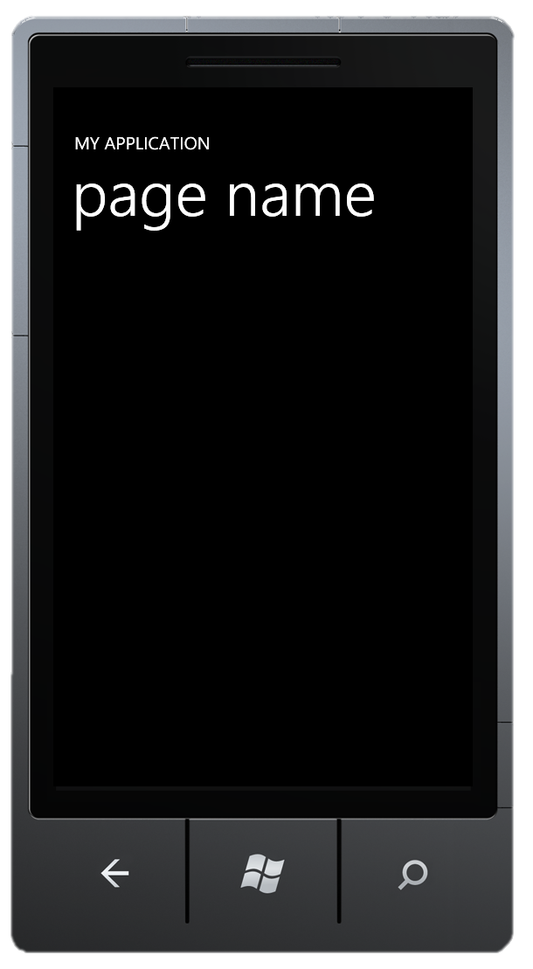
application structure
default control tree
PhoneApplicationFrame
PhoneApplicationPage
Grid named “LayoutRoot”
StackPanel named “TitlePanel”
TextBlock named “ApplicationTitle”
TextBlock named “PageTitle”
Grid named “ContentPanel”
<your content goes here>
you can clear the entire page content and write your own, but for most apps it is recommended to stay within the ‘metro’ guidelines

Slide 47
application structure
navigation
just like a web browser, each page in windows phone can be navigated to using the NavigationService by passing a URI
the PhoneApplicationFrame can only display a single page at a time!
the hardware back button can be used to go back to the previous page on the stack
you can pass data to the page using URI query or by placing it in a globally known location (such as the App class)

Slide 48
application structure
tombstoning
windows phone can only run one application at a time. so, each time you switch to another application, the current one gets terminated – i.e. tombstoned
your app will get tombstoned if:
you click the start button
you get a call while the app is running
the phone gets locked
the app uses a launcher or a chooser (e.g. use the camera)
you can use the app’s Activated and Deactivated events to handle tombstoning
Notes:
you get a few seconds to save the current state of the application to a permanent storage.
when the app gets reactivated, the user will expect it to return to the same state.
a good place to save state while the application is running is the page’s OnNavigatedTo/OnNavigatedFrom methods.

Slide 49
demo
tombstoning

Slide 50
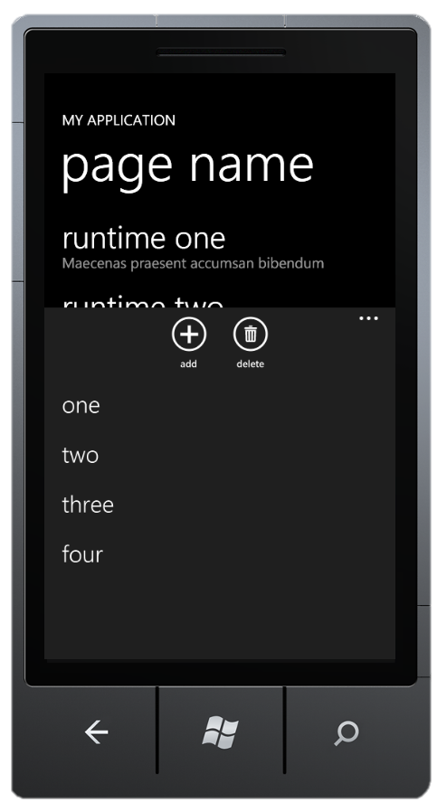
application structure
application bar
preferred menu system for your apps
up to 4 buttons, monochrome 62x62 bitmaps
add a button from Blend to get some default bitmaps
get more from http://thenounproject.com
add up to 5 menu items

Slide 51
demo
application bar

Slide 52
phone controls
most of silverlight’s controls have been adjusted to windows phone, supporting touch and templated to the phone’s theme
while some controls such as ComboBox and ToolTip exist on the phone, their use is discouraged

Slide 53
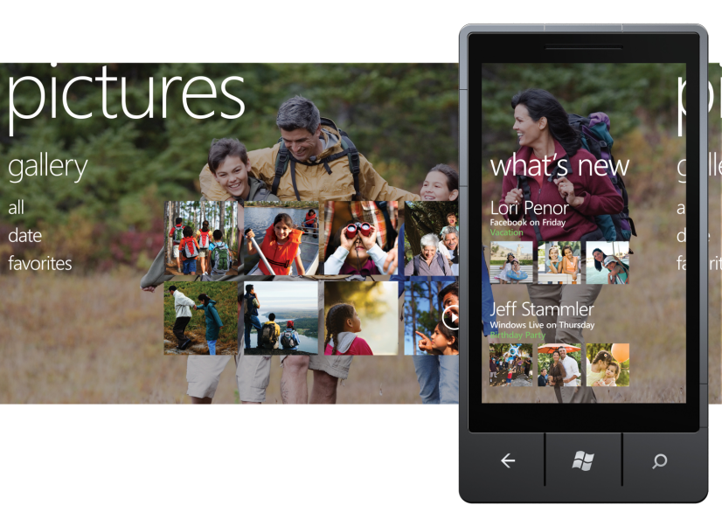
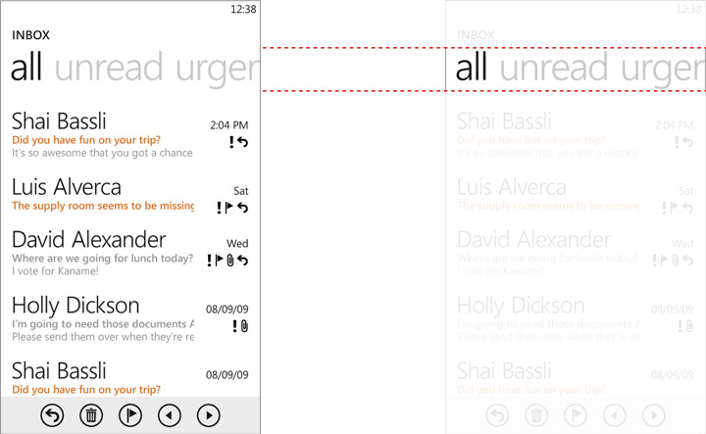
phone controls
panorama and pivot
panoramic applications offer a unique way to view controls, data, and services by using a long horizontal canvas that extends beyond the confines of the screen.
pivot can be used for filtering large datasets, viewing multiple data sets, or switching application views.

Slide 54
demo
panorama & pivot
Notes:
from scratch

Slide 55
sensors
accelerometer
measures acceleration forces such as gravity or the forces caused by moving the sensor
can tell the direction of the earth relative to the phone
use the Accelerometer class to access the sensor
this sensor reports a constant value in the emulator, so it is recommended that you mock its values for testing
possible uses: responding to phone movements in games, bubble levels, etc.

Slide 56
demo
accelerometer
Notes:
from scratch

Slide 57
sensors
geo-location
obtain the current location of the phone using the GeoCoordinateWatcher class
you can get the latitude, longitude, altitude and current speed of the device
this sensor is not available in the emulator. use the GpsEmulator project, available at app hub
use the Bing maps control to display a map of the current location

Slide 58
sensors
camera
obtain photos from the camera using the CameraCaptureTask chooser
get a Stream from the chooser and create a BitmapImage from it
the emulator will provide a simple black-and-white image to capture

Slide 59
demo
camera
Notes:
from scratch

Slide 60
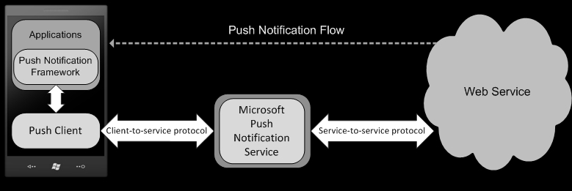
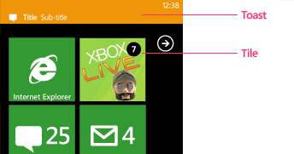
services
push notifications
allows applications to receive updates in the background (app doesn’t need to be running!)
three types of notifications:
toast – when app is inactive
tile (background, title, count)
raw – directly to the app
you need to create a compatible web service

Slide 61
what’s coming
in version 7.5 (aka “mango”)
internet explorer 9
SQL CE: in-memory local SQL database
multi-tasking and live agents
silverlight 4
raw camera feed access
tcp/ip sockets
better developer tools
beta sdk shipping this month

Slide 62
resources
Programming Windows Phone 7 by Charles Petzold (free ebook) http://www.charlespetzold.com/phone/
Windows Phone 7 Developer Guide http://msdn.microsoft.com/en-us/library/gg490765.aspx
quickstarts http://create.msdn.com/en-us/education/quickstarts
the noun project (icons for your app) http://thenounproject.com/

Slide 63
break

Slide 64
using azure in your app

Slide 65
windows azure
in a nutshell
Windows Azure and SQL Azure help developers build, host and scale applications through Microsoft datacenters. it allows you to:
focus on development not infrastructure
respond faster to customer needs
use your existing .net skills in the cloud

Slide 66
windows azure
features
compute (virtual server)
database
caching
content delivery network
service bus
access control
and more!

Slide 67
phone+azure
use azure web roles for hosting web services
e.g. push notifications
store data on azure tables
e.g. user registration, personalization
use the content delivery network (CDN) to host your media (images, videos, etc.)

Slide 68
phone+azure
toolkit
visual studio templates for an azure-backed windows phone app
provides:
user registration and authentication service
access azure tables using OData
serve push notifications
administration website

Slide 69
demo
toolkit app
Notes:
from scratch

Slide 70
resources
Windows Azure Toolkit for Windows Phone 7 http://watoolkitwp7.codeplex.com/
short introduction to azure http://msdn.microsoft.com/en-us/magazine/ee336122.aspx

Slide 71
the marketplace

Slide 72
marketplace
advantages
integrated into the phone
use the zune software to browse on the PC
free or paid apps with a trial option
downloads, updates and payments are managed for you
free registration for students using DreamSpark

Slide 73


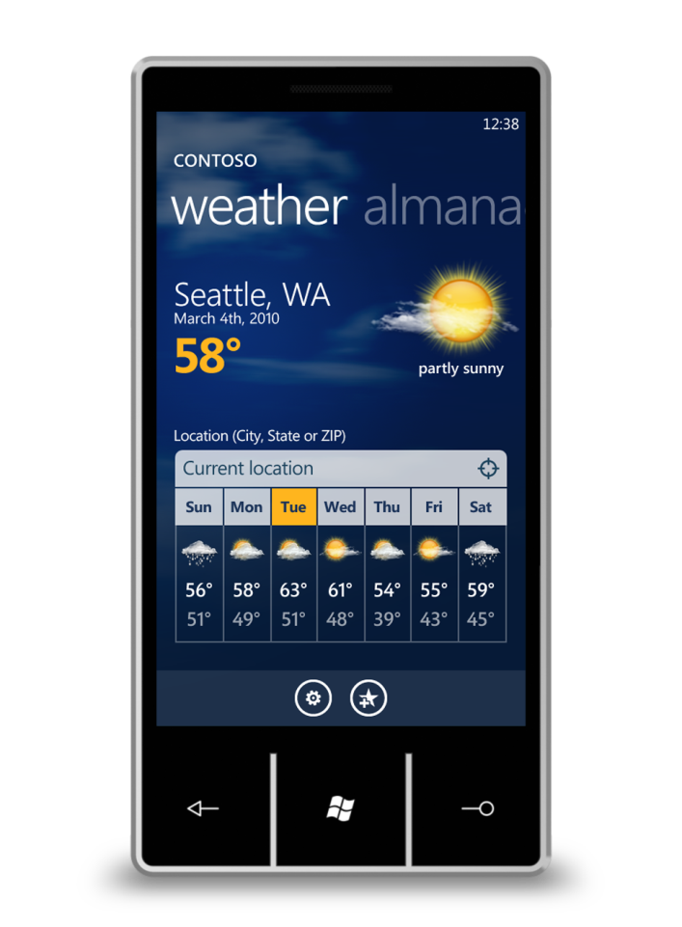
marketplace
steps
develop
& debug
submit & validate
certify
& sign
windows phone application deployment service
marketplace
Notes:
Certification pitfalls:
Always closes without exception
Must not be unresponsive for over 3s
Must launch within 5s
Back should close app and lead to prev page
Never delay a phone call
Content: no violence or sexual

Slide 74
marketplace
best practices
make it appealing (use metro!)
make it stable and reliable
make it original and useful
make it easy to use
read the certification requirements carefully
test your app as suggested to avoid common certification pitfalls

Slide 75
marketplace
in israel
currently not supported directly in App Hub
use a third-party broker: yalla apps
as a student, you get 100 credits which you can use to:
upload apps
unlock devices for development

Slide 76
resources
certification requirements http://msdn.microsoft.com/en-us/library/hh184843(v=VS.92).aspx
dreamspark https://www.dreamspark.com/
yalla apps http://www.yallaapps.com/
best practices for application marketing http://create.msdn.com/en-US/home/about/app_submission_walkthrough_application_marketing

Slide 77
thank you!

